Slide 1
Demand forecast: an example applied to petrol service stations

Slide 2
Case study and forecast methods
Service stations selling different products (fuels eg. Diesel, Gasoline …)
Historical series of sold product
How to forecast future demand?
Three approaches:
Long term prediction based on deseasonalisation of the historical trend
Short term prediction, based on:
Linear regression
Artificial neural network (ANN)
Short prediction using additional data
Linear regression
ANN

Slide 3
Data
Time series (one double x one day) related to the sold quantity of product
Additional data: weather conditions (past, current, and future, holidays, sold quantity of other products…)

Slide 4
Historical series
Basic hypothesis:
The day of the week (i.e. whether it is Monday, Tuesday…) is related with the quantity sold
Procedure:
We take into account the time series of one year
We group it by series of one week creating a 52x7 matrix
We verify correlation between rows
We compute the average of sold quantity for each week
We normalise the daily sold quantity for each day
We compute the average quantity sold for each day of a week
We de-seasonalise the quantities dividing by the respective average computed at the previous step
We compute the trend (e.g. linear)
We multiply the future values of the trend for the means computed at step 4.

Slide 5
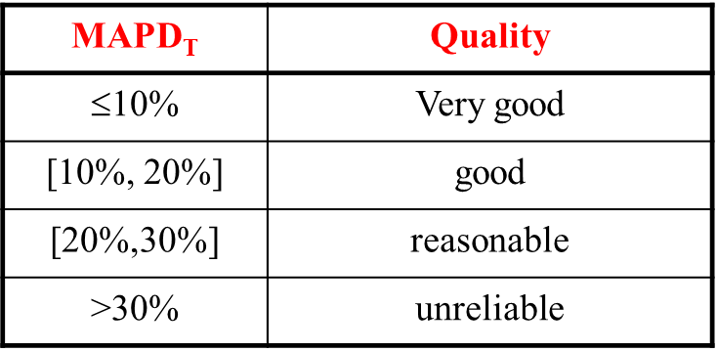
Results of the forecast on January and March 2012
January Mse=8*10^5 MAPE=34%
March Mse=8.49*10^5 MAPE=18%

Slide 6
Forecast as a linear combination
Objective: forecast demand on day i+7, given the sold quantity at days i… i+6
Procedure
Arrange the historical data in a sliding window of 7 days
Call for fitlm function to compute the demand stated in the objective
Results on 2011: MAPE=13%, MSE=2.46*10^5
Results on first 10 weeks 2012: MAPE=17%, MSE=5.47*10^5

Slide 7
Forecast by ANN
Just call nnstart and apply it to year2011 historical serie
Results on 10 neurons
MSE=2.3*10^5 (on training set 2011) MAPE not available
MSE=7.3*10^5 (on first 10 weeks 2012) MAPE not available
Results on 20 neuros
MSE=1.4*10^5 (on training set 2011) MAPE not available
MSE=3.2*10^6 (on first 10 weeks 2012) MAPE not available
Results on 2 neuros
MSE=3.6*10^5 (on training set 2011) MAPE not available But R<0
MSE=8.5*10^5 (on first 10 weeks 2012) MAPE not available But R<0
Results on 7 neuros
MSE=1.65*10^5 (on training set 2011) MAPE not available But R<0
MSE=2.5*10^6 (on first 10 weeks 2012) MAPE not available But R<0

Slide 8
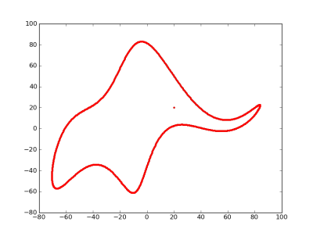
So, how many neurons?
Ask to the elephant!
With four parameters I can fit an elephant, and with five I can make him wiggle his trunk*
*Attributed to von Neumann by Enrico Fermi, as quoted by Freeman Dyson in "A meeting with Enrico Fermi" in Nature 427 (22 January 2004) p. 297
https://www.nature.com/articles/427297a

Slide 9
Saving your ANN function
function [y1,xf1] = myNeuralNetworkFunction(x1,xi1)
%MYNEURALNETWORKFUNCTION neural network simulation function.
%
% [y1,xf1] = myNeuralNetworkFunction(x1,xi1) takes these arguments:
% x1 = 1xTS matrix, input #1
% xi1 = 1x7 matrix, initial 7 delay states for input #1.
% and returns:
% y1 = 1xTS matrix, output #1
% xf1 = 1x7 matrix, final 7 delay states for input #1.
% where TS is the number of timesteps.
Xi1 (length 7)
Xf1 (length 7)
x1
y1

Slide 10
Exercises
Linear model prediction vs ANN in forecast of demand on two products
Linear model prediction vs ANN in forecast of demand on two products taking into account weather conditions

